Slide 1
Upgrading Microsoft SQL Server 2000 to SQL Server 2008 R2/2012/2014 for Applications
Team: Srihari, Smitin, Narhari, Han

Slide 2
Upgrading Microsoft SQL Server 2000 to SQL Server 2008 R2/2012/2014 for Applications
Executive Summary
We would like to thank ITU for giving us the opportunity to submit this proposal for upgrading Microsoft SQL Server 2000/2005 to Microsoft SQL Server 2008/2012/2014 program. We understand that upgrading from Microsoft SQL Server 2000 /2005 to Microsoft SQL Server 2008/2012/2014 is a key initiative and we fully committed to make it a success.
We value the opportunity that the proposed engagement will bring towards extending the long-standing relationship between Client and Us. As before, we will be completely committed to leveraging its consulting-led, integrated portfolio of IT and IT-enabled services delivered through its unique Global Network Delivery Model, to ensure certainty in interaction, solution, timelines and quality of delivery.

Slide 3
Upgrading Microsoft SQL Server 2000 to SQL Server 2008 R2/2012/2014 for Applications
Scope of Services
The services understood to be in-scope for this proposal are:
Upgrading Database of boundary applications Kronos Workforce Timekeeper (TM) 4.3 and Concur
Upgrading Database from SQL server 2000/2005 from SQL Server 2008/2012/2014.
Conversion of DTS Packages into SSIS Packages. Upgrading 2005 SSIS Packages.

Slide 4
Out-of-Scope
We lists the following items are excluded from the scope of this proposal:
Application testing will be done by Kronos and Concur support teams, respectively.
Interfaces will have no changes unless specified by the Client.
Any Change/Modification in third party applications

Slide 5
Assumptions
The assumptions for this project are listed below.
Client will provide all the required licenses
Client will provide all the required tools for Database testing, in case of special test requirement.
Client will ensure the timely availability of infrastructure which is required for this upgrade.
Client will provide all the necessary access required by DBA team for the upgrade.
Client will ensure timely approvals from their internal clients/departments to carry out the project.
Client will ensure the availability of application team/third party vendor & business users during the UAT testing phase.
The applications in scope are not validated applications
Client will provide all the required infrastructure for this project e.g. servers, storage etc.
Client will nominate a single point of contact for the our project team, who will be responsible for arranging meetings, access to environment, test data, clarification of queries, acceptance of document and software, etc.
Client will provide all the tools in case any special testing is required.
Client will provide all adequate office facilities, infrastructure, seating arrangements, office utilities like phone, fax, e-mail, internet, hardware, software, related documents and so on to the project team
Approximately 700 DTS packages are considered for migration to SSIS packages for effort calculations in which 50% Simple, 30% Medium & 20% Complex packages are assumed.

Slide 6
Proposed Solution
We proposes a robust and innovative solution which would be best fit for Client’s current and future business requirements, addressing both technical and non-technical requirements. This section describes the solution approach for addressing the needs of upgrade. The implementation of MS SQL server 2008 R2/2012/2014 will overcome the limitations of MS SQL 2000 server. The MS SQL server 2008 R2/2012/2014 has Visual Studio which includes SQL server integration services (SSIS) and SQL server reporting services (SSRS).
Our solution consists of the following:
Database Upgrade
Database Migration
Migration of DTS Packages to SSIS
Upgrading 2005 SSIS Packages to 2012 SSIS Packages.
Implementing High availability (Always on Availability Groups)

Slide 7
In-Place Upgrade
Using an in-place upgrade strategy, the SQL Server 2008 Setup program directly replaces a SQL Server 2000 instance with a new SQL Server 2008 instance on the same x86 or x64 platform; the upgraded instance of SQL Server 2000 is replaced by the new SQL Server 2008 instance. There is no need to copy database-related data from the older instance to SQL Server 2008 because the old data files are automatically converted to the new format. When the process is complete, the old SQL Server 2000 instance is removed from the server, with only retained backups able to restore it to its previous state.

Slide 8
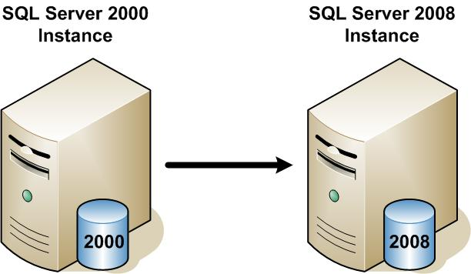
Figure 1: Direct upgrade of SQL Server 2000 to SQL Server 2008/2012/2014

Slide 9
Side-by-Side Upgrade
In a side-by-side upgrade, database structure and component data are transferred from the SQL Server 2000 instance to a new, distinct SQL Server 2008 instance; the new SQL Server 2008 instance runs alongside the legacy SQL Server 2000 either by using two servers or a single server.

Slide 10
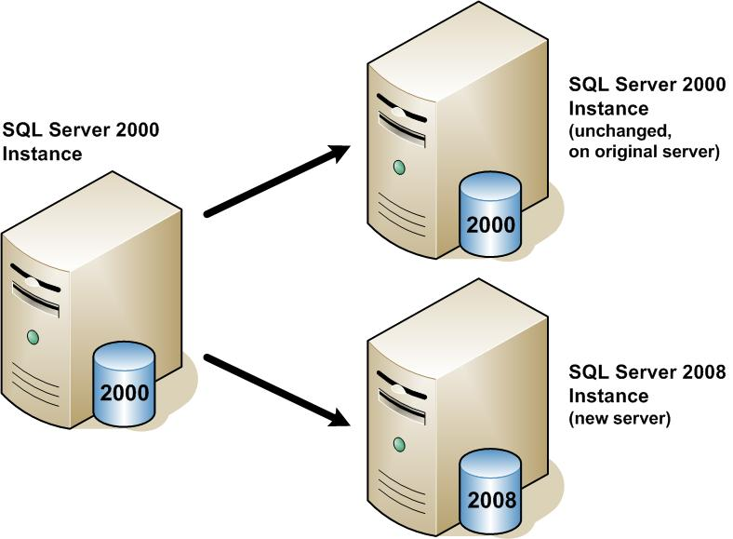
Figure 2: Side-by-side upgrade to SQL Server 2008/2012/2014 using two servers

Slide 11
Database Migration Steps
We will start with creating checklists by referring to the deprecated, discontinued or known code break down code as part of Pre-migration activity and also create Acceptance test criteria and baseline performance required. Use upgrade assistance tools to identify deprecated / discontinued features or breaking changes then fix the issues and have scripts for the unsupported features. In addition, we will use SQL and operating system inbuilt tools such as System Monitor— SQL Server: Deprecated Features Object Best Practices Analyzer for SQL Server 2000 then Fix issues. If it is successful, then we will migrate the database and then apply post-upgrade scripts. If in case due to any unforeseen issues the upgrade is not successful, then database rollback process will be initiated.

Slide 12
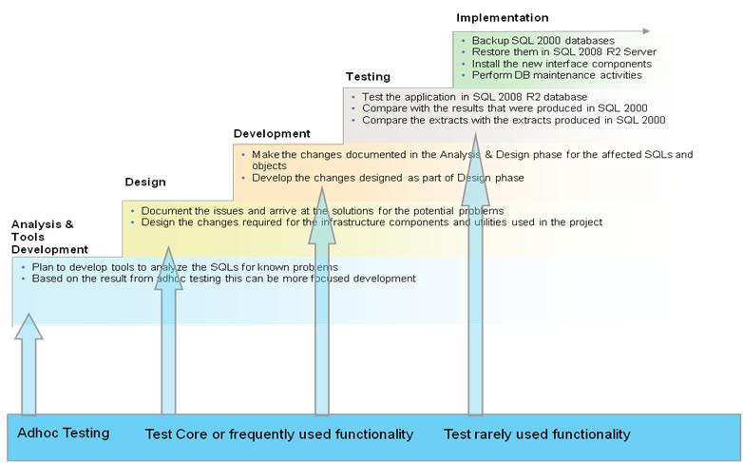
Figure 5: Database Migration Steps

Slide 13
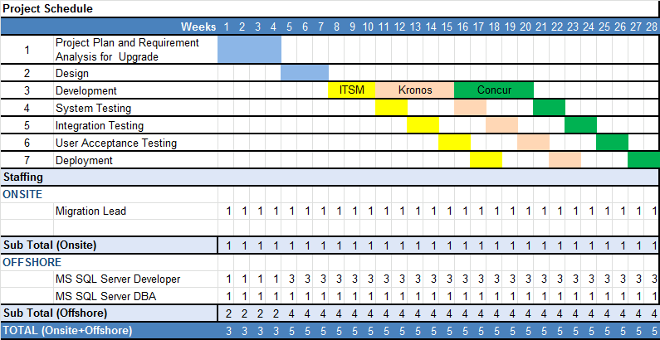
Schedule and Staffing

Slide 14
Implementation Schedule
Task/Milestone | Scheduled Completion Date
Complete Upgrade Design | Feb 1, 2016
Complete Testing | Mar 1, 2016
Complete System\Integration Testing | Mar 10, 2016
Verify Functionality on New SQL Servers | Apr 1, 2016
Complete Data Migration | April 15, 2016
Go Live/Launch | Apr 20, 2016
Operational Acceptance | May 1, 2016
Change Request (AOAG) Implementation | June 1, 2016
Testing and Go live | June 15, 2016

Slide 15
Risk Management
S.No | Risk | Risk Level | Responsibility | Likely occurrence | Area of impact | Measure
1 | Availability/set –up of development, testing , performance testing and hosting environment | High | Client/US | Medium | Acceptance Testing | Co-ordinate with Client Personnel for setting up the hosting environment by end of Design phase
2 | Delay in Review and Acceptance of the Design Documents by Client | High | Client/US | Rare | Project schedule | Client need to ensure that the Design Documents are reviewed and approved before the start of the Construction Phase
3 | Delay in completion of User Acceptance testing (UAT) | High | Client/US | Medium | Acceptance Testing | Client need to ensure that UAT will be completed in the agreed period.
Table 2: List of Risks

Slide 16
Risk Management
4 | VPN link connectivity loss | Low | Client/US | Rare | Project schedule and Effort | Both Client and we need to ensure that the VPN link does not fail or has sufficient fail over alternatives
5 | Performance may not increase after migration. | Low | Client/US | Rare | Testing | Both Client and we need to ensure that performance testing and performance recommend solutions.
6 | Application functionality may impact after migration | Low | Client/US | Rare | Testing | Client need to ensure that functional testing will be done in UAT and will be completed in the agreed period

Slide 17
Schedule and Staffing
It is estimated that this project will be completed in about 28 weeks. The projected schedule is shown below and is subject to change in case the there is any change in requirement during the requirement gathering.

Slide 18
Commercials
The estimated cost for this project will be USD 291, 200 excluding any applicable taxes.
The team will consist of four team members located in USA.
If the offshore team option is considered, the project cost will be USD 98560.
Following are the rates used for this project:
Implementing High Availability: Estimation Hours : 100 Hours Per Server
Price Per Hour: $150
Total Cost for Implementing HA: $15000 Per Server.
AMS Roles | Experience (Years) | India (USD) | US (USD)
MS SQL Server DBA | 3-5 Years | 22 | 65
SQL Server Developer | 3-5 Years | 22 | 65
Always On Availability Group | 3-5 Years | - | 150

Slide 19
Change Request
While the Upgrade database project is ongoing, we receive a Change request from Customer for Implementing Disaster Recovery and High Availability Techniques for New SQL Servers.

Slide 20
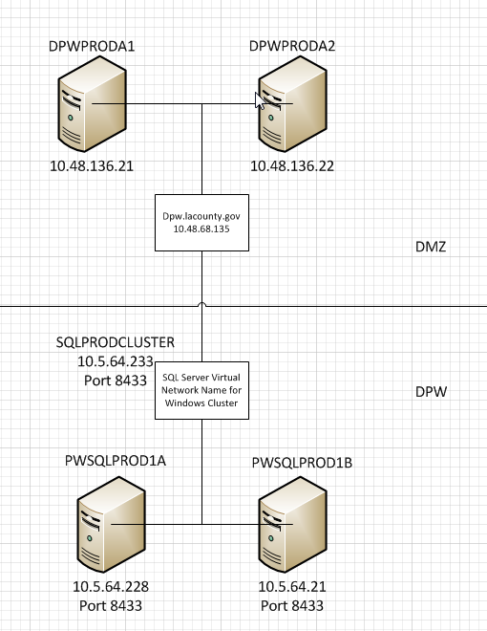
Windows Fail Over Cluster

Slide 21
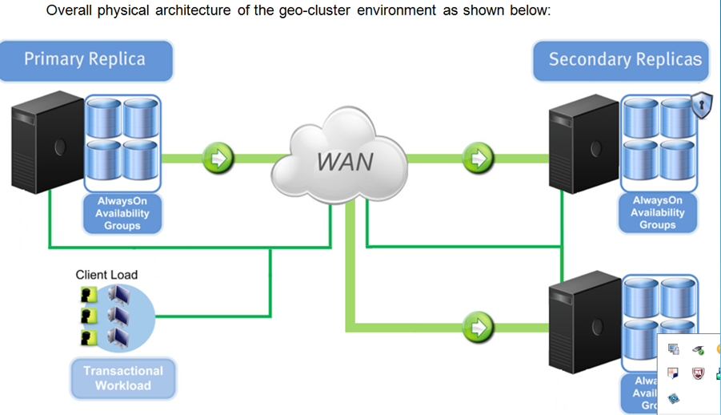
AlwaysOn Availability Group Architecture

Slide 22
Stages of Always On
After the initial AG has been created, any additional DB added to the AG must be an online, read/write DB on the server that hosts the primary:
Adding a new DB to an AG keeps the DB online to clients, but no secondary exists until a backup of the data+tran.log has been restored to the secondary replica host.
The AG then initiate data sync b/w secondary DB and its corresponding primary.
During Sync the primary sends the Tlog records from the 1st -> 2nd which in turn writes the serial records to disk while applying the log to 2nd.
During a failover, the role of the availability replica may become indeterminate and their role will be set to resolving until the role of the replica is resolved.
If the availability replica is resolved to the primary role, the DBs become the primary.

Slide 23
AOAG Concept
The basic concept of Always On is to take the database mirroring – like data- moving capabilities combined with the Windows Clustering failover capabilities.
Provide a single seamless environment that allows for the failover of databases between physical servers without any single points of failure
Mirroring deprecated, but supported till 2021.

Slide 24
THANK YOU

